Slide 1


A WARM WELCOME TO OUR SVAR VANDANA FAMILY

Slide 2
About us
About us
Svar-Vandanais a Musical journey which began in 2013 in which our endeavour is to showcase the rich heritage of Indian Music and Dance and where interested students from an early age can pick up, appreciate and gain expertise in various Music & Dance disciplines. The Music Academy has been established in 2013 to spread the awareness of Indian Classical and Semi-Classical Music - vocal of different styles as well as Instrumental of various traditional Indian instruments along with traditional Indian forms of dances. Apart from overall development, this interaction can give them platform to hone and show-case their talents and if they excel in a field of their interest, they can pursue this as a career.
Svar-Vandana –
A Musical journey which began in 2013.
Our endeavour is to showcase the rich heritage of Indian Music and Dance where interested students of all ages can pick up, appreciate and gain expertise in various Music & Dance disciplines.
Apart from overall development, this interaction can give them a sense of achievement, creativity and positivity and they are generally happier and can relate to the challenges in life more efficiently and effectively.

Slide 3
Multiple Centers
Noida Sector 48
A - 181, Sector - 48, Noida - 201301 Email: info@swarvandana.com Contact no:- 0120-4213725/ 9910494141
Noida Sector 122
Pk-5,Sector-122,Noida
Email:info@swarvandana.com
Contact no:-9899219816
Gurgaon Sector 40
SCO - 70, Sector - 40, Huda Market, Gurgaon, Haryana - 122002 Email: info@swarvandana.com
Contact no: 0124- 4371653 / 9643250627
Noida Sector 62
Plot No 1, Institutional Area, Indus Valley Public School, Sector 62, Noida 201301 Email: info@swarvandana.com Contact no:- 9711276501

Slide 4

OUR VISION AND MISSION:
Present environment- Overall decaying of Indian values, rampart corruption, crime and aggression ,dearth of role models, tough academics, peer pressure, nuclear families with working parents, ruthless competition, stressful work environment, demanding schedules and challenges of living in a metro.
Effect on our minds- Our generation is confused and lost and vulnerable to many stress and lifestyle related problems.
Our Belief- Music & Dance is the one solace that they can rely upon and which will give them inner strength, self discipline and a sense of achievement, creativity and positivity.
Our Mission – To provide Music Academies to the young generation and also their parents and grand parents to experience the rich tradition of Music & Dance where by the exposure to the rich heritage of India they can give expression to their latent talent and creativity.
Our Vision- Our Music Academies will become Happiness Centers for children, youngsters, stressed out executives, homemakers and senior citizens.
Our Plan – For a wider reach in the minimum possible time, we plan to open and operate Multiple Centers for which we are selecting interested Franchise Partners. We are also leveraging the power of Music & Dance in Corporates as an Employee Engagement Tool.

Slide 5
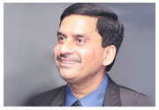
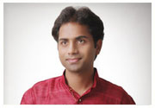
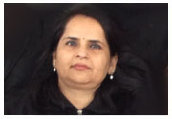
Management
Team
Schools
Corporates- Employee Engagement&Retention Programs
Hospitals-Music Therapy
Pan India
Franchisee

Slide 6
Dr.Bipul Kumar Ray :- is one of the finest santoor exponents of the country. Under the tutelage of Santoor maestro Pandit Bhajan Sopori, an outstanding exponent of "Sufiyana Gharana” of Kashmir, He has a Master and M. Phil degree in Classical vocal music and Doctorate (PhD) on Santoor from the University of Delhi. He is our Advisor and currently working on the therapeutic effect of Music on various stress related ailments. Svar Vandana will soon introduce Music Therapy sessions.

Slide 7
Sanjay Sarda :-B.Tech from B.I.T and Post Graduate from IIM Kolkata. Worked in several leading Corporates of India in various assignments in senior positions. After doing the corporate grind for 32 years, decided to follow a ‘dil-se’ call to set forth on a path less trodden and took sabbatical from the corporate world in Aug 2013 to open a Music Academy in Noida. Svar Vandana already has 4 Music Academies – 3 in Noida and one in Gurgaon. He plans to open many such state-of-the-art Academies by 2020. He is the Chairman of Svar Vandana and the driving force of this journey.

Slide 8
Meenakshi Sarda: M.A in Psychology and Gold Medallist from Kurukshetra University is a trained Vocalist who has done various counselling and mentoring assignments with children. She is a trained trainer for SEN children. She is our Director and her role is like a Mentor for students, parents and our faculty.

Slide 9
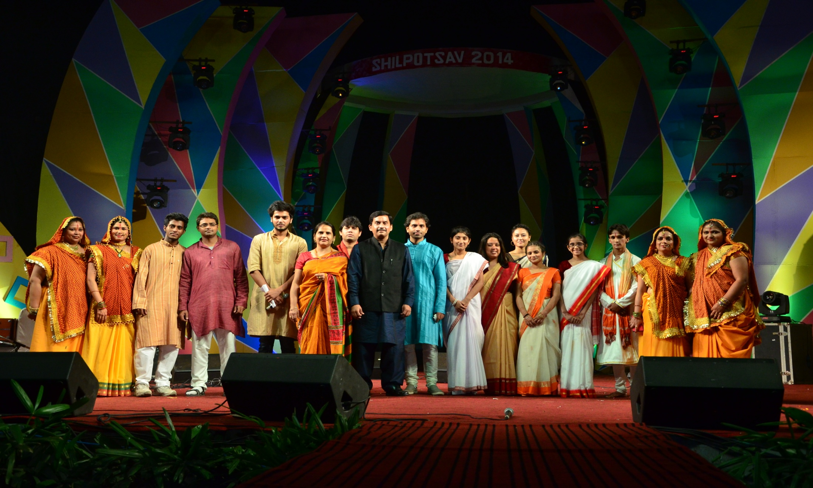
LET US BEGIN YOUR memorable musical journey
Hobby Classes for Children – to give them a flavour of the
richness of Indian traditional Music & Dance thereby helping
their concentration, discipline, sense of achievement and creativity.
Home Makers – Body & Mind fitness thru Music & Dance.
Executives: As a Stress Buster and Relaxation tool and overall positivity.
Retired senior citizens – Good utilization of their spare time.
AND FOR EVERYONE –
TO INCREASE THEIR HAPPINESS QUOTIENT

Slide 10
Area Of Work
Svar-Vandana offers Hobby Classes as well as Diploma, Bachelor and Master Degree Level programmes in the following subjects:
Vocal
Hindustani Classical Vocal Music : Khayal, Dhrupad.Semi Classical Vocal (Thumri,dadra,Tappa,Chaiti) -Sugam Sangeet: Geet,Ghazal,Bhajan
Instrumental:
1-String Instruments: Santoor , Sitar, Guitar, Violin,
2-Wind Instruments: Flute, Harmonium
3-Western Instruments: Piano, Keyboard, Organ, Guitar* (Bass, Spanish, Electric)
4-Percussion Instruments: Tabla,Pakhawaj , Dholak, Congo, Bongo, Jazz Drum
Dance:
1-Indian Classical Dance – Kathak. Bharatnatyam, Oddisi
2-Folk Dance – Bhangra ,Dandiya and all other Indian Folk dances.
3-Bolywood– Contemporary and all others.
4-Western Dance Forms: Zumba, Aerobics, Contemporary, Free Style, Salsa, Jazz, Hip-hop, Cha-Cha-Cha, Belle, Ballroom, Rock n Roll, Rap Dance etc

Slide 11
Affiliations:
We are affiliated with major UGC accredited Music Societies of India (Prayag Sangeet Samiti-Allahabad, Prachin Kala Kendra -Chandigarh) for Hindustani Vocal, Tabla and Kathak.
We are also affiliated with Trinity College- London, whose certifications are world renowned, for Guitar, Keyboard, Piano and Drums.
.

Slide 12
Additional Features
1- Training and grooming interested candidates for Reality Shows.
2- Music Therapy sessions to select SEN students.
3-Annual tie-ups with Schools to provide support in all Music & Dance activities in workshops at the School.
4.Tie-ups with Malls to conduct weekend live music & dance shows by students.
5-Ties-ups with Corporate for special customised packages for their executives.
6-Customised packages for homemakers for Zumba, Aerobics, Meditation etc.
7-Preparing students for B.A,M.A Music entrance, Govt. Scholarships from Ministry of Culture (CCRT), scholarship to young artists in Radio and TV.
8. We are in discussion with ICCR for empanelling our Academy.

Slide 13
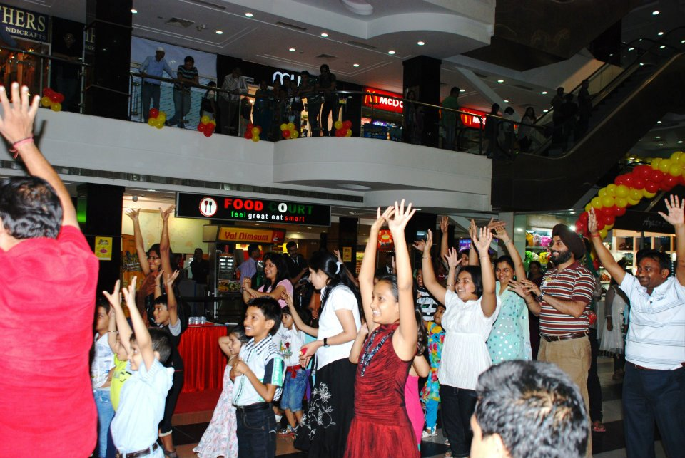
Organising Workshops In Malls

Slide 14
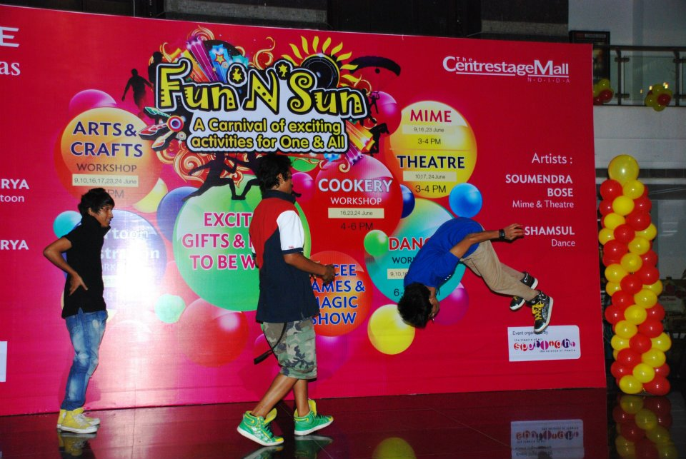
Western Dance Workshop

Slide 15
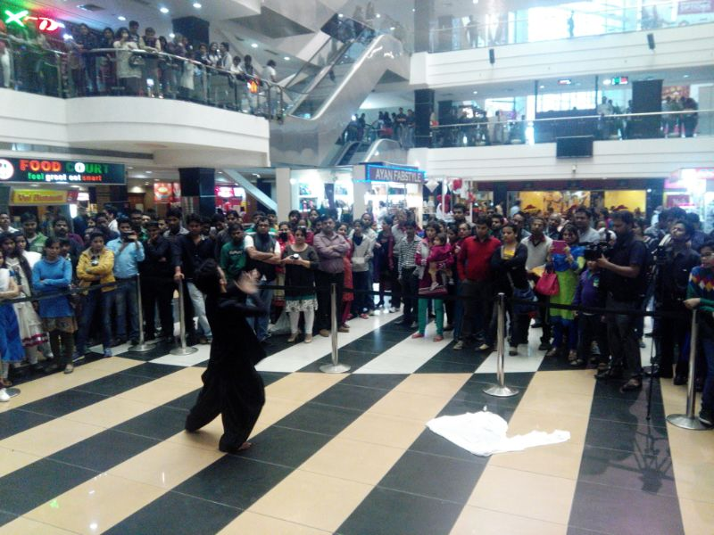
Performance In Wave Malls

Slide 16
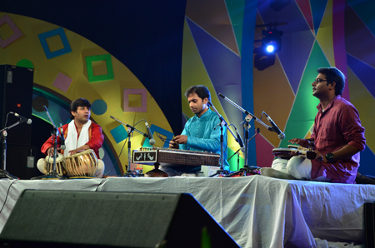
A Classical Evening with Svar Vandana

Slide 17
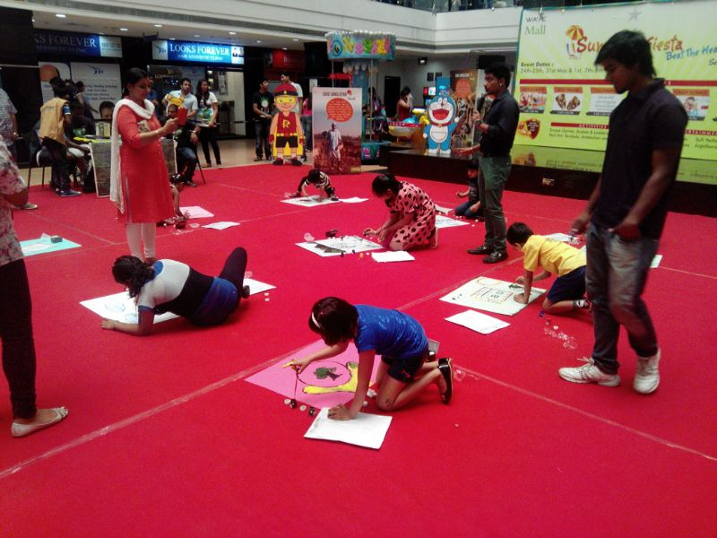
Art & Painting Workshop

Slide 18
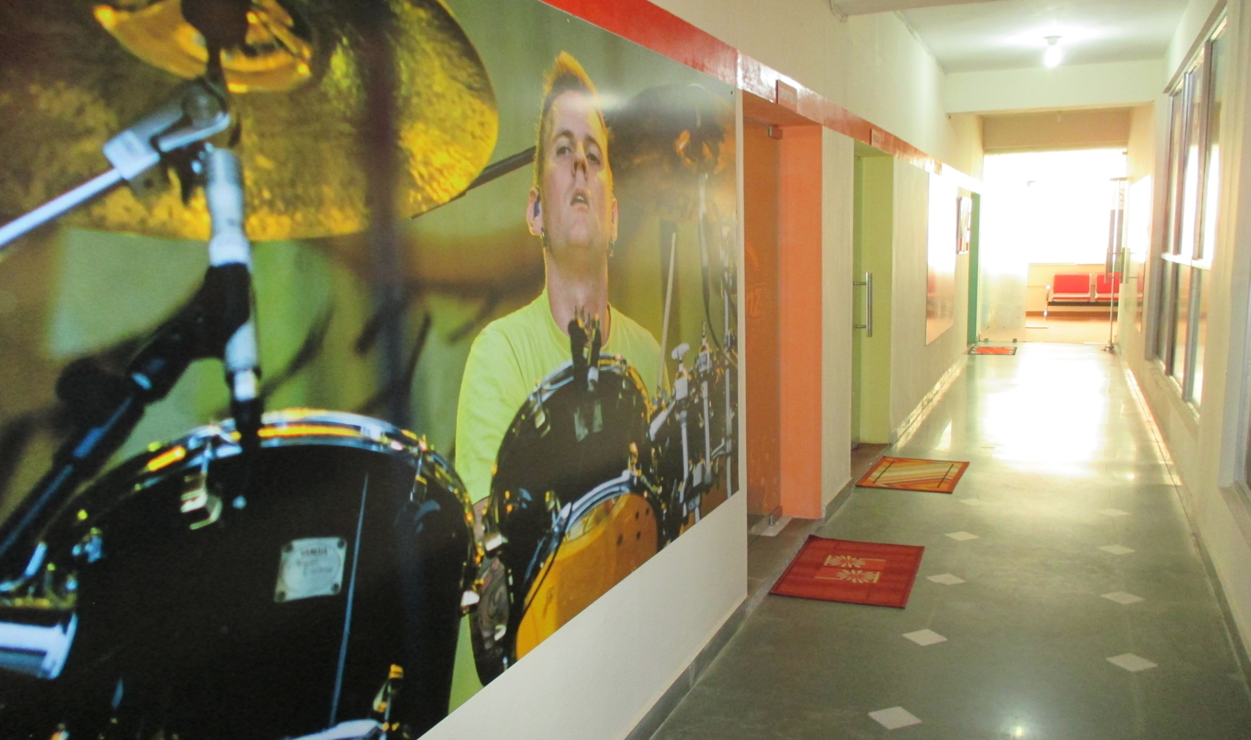
Svar Vandana Academy

Slide 19
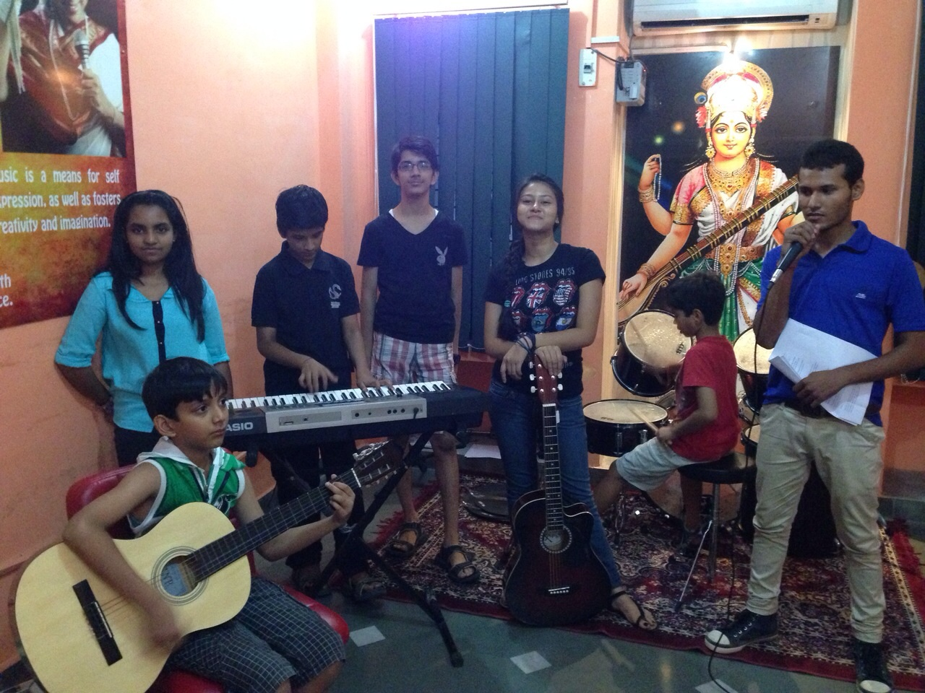
Junior Rock Band Svar Vandana

Slide 20
YOUR INPUTS & SUGGESTIONS
Your inputs and suggestions are invaluable to us and feel free to give us
the same to help us improve further and come up to your expectations.
You may write email to our Chairman Mr.Sanjay Sarda at
sanjay@swarvandana.com
Or call him at 7838330700/ 9958027555.
Similarly your words of encouragement and Testimonials and
Acknowledgments make our whole effort worthwhile and we feel
inspired and motivated by them so please give these as well.

Slide 21
THANK YOU

